Slide 1

Data Warehousing Fundamentals
Topic 02

Slide 2
Contents
Introduction
What is a Data Warehouse?
Why Data Warehousing?
History of Data Warehousing
Definition of Data Warehousing
Data Warehouse Architectures
Data Warehouse vs Transactional Database
Requirements for a Data Warehouse
Reasons for a Data Warehouse

Slide 3
Recap
Introduction
In Topic 1, you learnt:
What is Business Intelligence (BI)?
Why do companies use BI?
Components of a BI solution
Data sources
Data Preparation
Data Warehouse
Data Analysis
Data Presentation
Data Source
Data Preparation
Data Warehouse
Data Analysis
Data Presentation

Slide 4
Deep-dive into Data Warehouses
Introduction
In this topic, you will learn more about:
What is a data warehouse
Why do companies build a data warehouse
How to build a data warehouse
Concepts related to data warehouses
OLAP vs OLTP
Multi-dimensional Model (using Star / Snowflake Schema)
The ETL (Extract-Transform-Load) Process

Slide 5
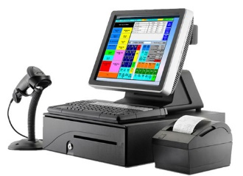




What Is a Data Warehouse (DW)?
Data from Point-Of-Sales systems
Data from Inventory system
A very huge database specially designed to enable Business Intelligence activities
Data stored in the DW is uploaded from operational systems such as sales, marketing etc.
DW keeps historical data which can be used to create annual / quarterly trends reports for management
Data Warehouse
Data from online-orders
Data from Marketing database
Data from HR database

Slide 6





Data from Point-Of-Sales systems
A Data Warehouse integrates data from different sources of an organisation’s operational systems
Data from Inventory system
Data Warehouse
Data from online-orders
Data from Marketing database
Data from HR database

Slide 7

Data Warehousing
Why are companies turning to Data Warehousing?
The process of constructing and using a data warehouse is known as “Data Warehousing”
More and more companies are setting up data warehouses due to the following phenomenon:
the huge increase of data stored in recent years, often spread over different systems
increasing global competition causing the need to make speedy yet informed decisions
Help! Drowning in the huge volume of data…

Slide 8
The Problem
Why are companies turning to Data Warehousing?
In this information age, many companies use IT systems to store their valuable company data
Many companies do not use one single IT system to keep the data, but often use disparate systems that store data in vastly different ways
E.g. ordering system using Oracle database, marketing database using SQL Server etc
Data from Point-Of-Sales systems
Data from Inventory system
Data from Marketing database

Slide 9

Good decisions need data
Why are companies turning to Data Warehousing?
To stay competitive, companies need to be able to make quick and well-informed decisions
To do so, companies need easy and speedy access to relevant data that are stored in their various operational systems
Companies need to make good decisions to stay competitive

Slide 10
But they can’t get it ☹
Why are companies turning to Data Warehousing?
In recent years, the amount of data stored by IT systems has increased dramatically.
However, a lack of integration between different systems makes it very difficult for companies to use these data

Slide 11
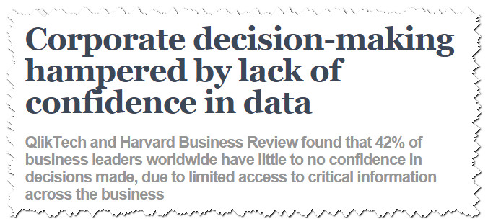
Decisions end up as guess-work ☹
Why are companies turning to Data Warehousing?
As such, instead of relying on real data and facts based on historical trends to drive strategic direction, companies end up making decisions based on experience, limited and sometimes outdated information.

Slide 12
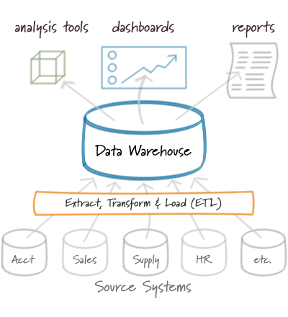
The Solution – Data Warehouse
Why are companies turning to Data Warehousing?
To solve this problem of ‘unreachable’ fragmented data, more and more companies have turned to the use of data warehouses
By building a data warehouse, a company can integrate all its most important data residing in different systems to a central location – with a SINGLE VERSION OF TRUTH
After the data warehouse has been built, the company can then use BI tools to access the data to help them make the best strategic decisions

Slide 13

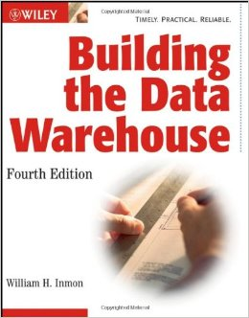
History of Data Warehousing
The concept of data warehousing dates back to the 1970s when Bill Inmon, often known as the “Father of Data Warehousing” first introduced the concept
The first book on Data Warehousing was published by Bill Inmon in 1992 and he was also the first person to offer classes in this subject

Slide 14

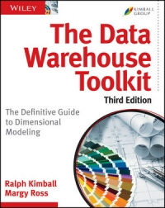
History of Data Warehousing
In 1996, Ralph Kimball published “The Data Warehouse Toolkit”
In his book, Kimball proposed a different way of modelling a data warehouse that is somewhat, almost the opposite of Inmon’s
His methodology, also known as dimensional modeling or the Kimball methodology, has become the de facto standard

Slide 15
Definition from Bill Inmon
Definition of Data Warehouse
Different people have different definitions for a data warehouse.
The most popular definition came from Bill Inmon, who provided the following:
A data warehouse is a subject-oriented, integrated, time-variant and non-volatile collection of data in support of management's decision making process

Slide 16
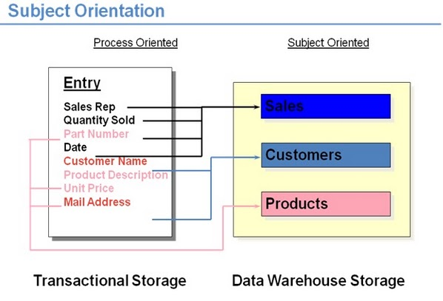
Subject-Oriented
Definition of Data Warehouse
Organised around the subjects the business users are interested to analyse, instead of around the operational applications that are used by the company
Focused on storing the data for decision makers, not on transaction processing
Provides a simple and concise view around the particular subjects by excluding data that is not useful in the decision support process

Slide 17
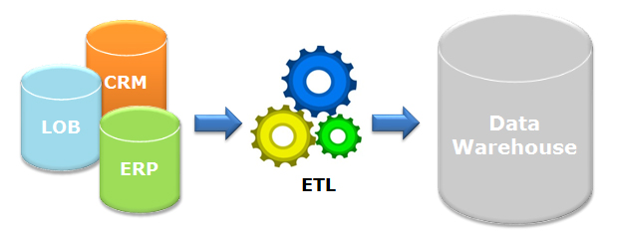
Integrated
Definition of Data Warehouse
Constructed by integrating data from multiple heterogenous sources
Relational databases, flat files, on-line transactional records
Data cleansing and data integration techniques are applied before data is stored in the warehouse
Ensure consistency in naming conventions, encoding among different data sources e.g. always “Singapore” instead of “SG“, “S’pore”

Slide 18
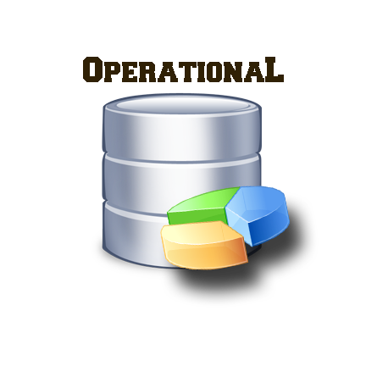

Time-variant
Definition of Data Warehouse
A data warehouse keeps historical data
For example, one can retrieve data from 3 months, 6 months, 12 months, or even older data from a DW
This contrasts with a transactions system, where often only the most recent data is kept
For example, a transaction system may hold the most recent address of a customer, but a data warehouse can hold all addresses associated with a customer.
Time horizon: up to 90 days
Records are updated
Not compulsory for key structure to contain an element of time
Time horizon: 5-10 years
Sophisticated snapshots of data
Key structure contains an element of time

Slide 19
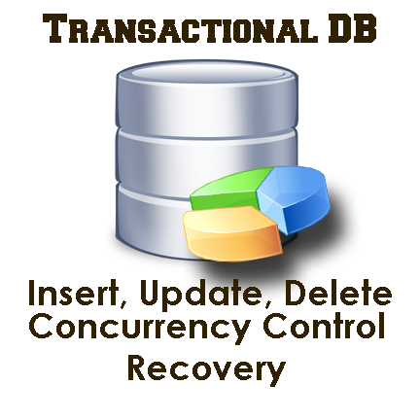
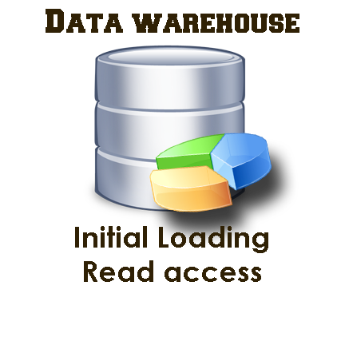
Non-volatile
Definition of Data Warehouse
Non-volatile means that once data is entered into the warehouse, it would not be changed (i.e. no updates or deletes)
This is logical because the purpose of a DW is to enable you to analyse what has occurred
Do not need concurrency control or recovery capabilities, unlike transactional databases
Data warehouses only involve 2 operations – initial loading of data and access of data (read)

Slide 20
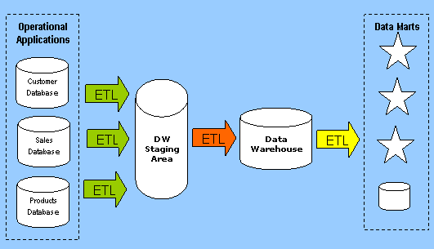
Data Warehouse Architectures
Data Warehouse Architectures
Data Warehouses can be architected differently, depending on business needs
5 commonly used DW architectures, two of them are shown below
Centralized DW - 2-layer Architecture
Hub-and-Spoke 3-layer Architecture

Slide 21
Five Main Data Warehouse Architectures
Data Warehouse Architectures
Centralized Data Warehouse
Data Mart Bus Architecture
Federated Architecture
Hub-and-Spoke
Independent Data Marts

Slide 22
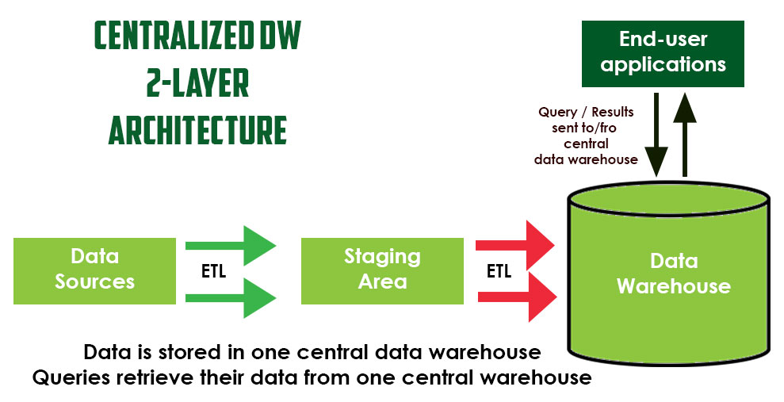
Centralized Data Warehouse Architecture Two-layer Architecture
Data Warehouse Architectures
In this architecture, there are 2 components: data warehouse and staging area
First, data is extracted from operational systems into a staging area
The data in the staging area is cleansed and transformed before it is loaded into the data warehouse
The process that does the extraction, transformation and loading of data is known as ETL (Extract,Transform,Load)

Slide 23
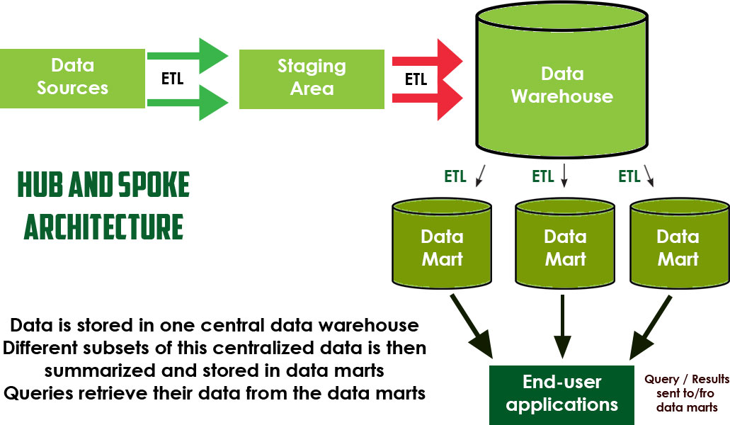
Hub and Spoke Architecture Three-Layer Architecture
Data Warehouse Architectures
In this architecture, there are 3 components: a data warehouse, a Staging Area and several data marts
Here, the end-user does not query the data warehouse directly but queries the data marts instead
Data marts contain subsets of data tailored for a specific line of the business, e.g. sales data mart is designed for sales related queries
Notes:
Also known as Corporate Information Factory (CIF)

Slide 24
Independent Data Marts Architecture
Data Warehouse Architectures
In this architecture, there are 2 components: a Staging Area and several independent data marts
Absence of a central data warehouse to control data structure compliance, hence, one data mart can be very different from another
Analytic tools query data directly from data mart and present information to user

Slide 25
Data Mart Bus Architecture
Data Warehouse Architectures
In this architecture, there are 2 components: a Staging Area and several dimensional data marts
Similar to independent data marts, does not have central data warehouse
Unlike independent data marts which can have completely different structures from one another, dimensional data marts conform to an agreed set of dimensions at the enterprise level
Also known as Kimball Bus Architecture

Slide 26
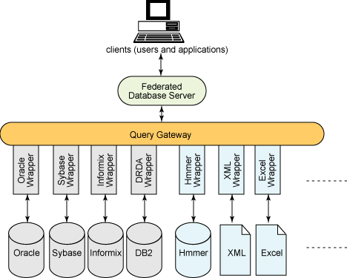
Federated Architecture
Data Warehouse Architectures
In this architecture, existing structures are left in place
Instead, a single database is set up to act as a federated database server which will receive requests from users, get the data from different data sources and return th results to the users

Slide 27
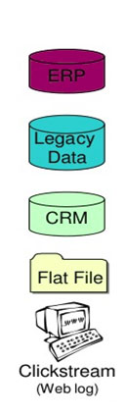
Operational Data Sources
Data Warehouse Architectures
Different data sources that feed data into data warehouse.
Formats like plain text file, relational database, Excel file
Many different types of data can be a data source:
Operations -- such as sales data, HR data, product data, inventory data, marketing data, systems data
Web server logs with user browsing data
Third-party data, such as census data, demographics data, or survey data
Real-time data, such as Internet of Things (IoT) devices
Operational data sources are typically current and volatile

Slide 28
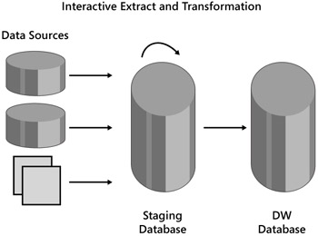
Staging Area
Data Warehouse Architectures
A temporary location where data from source systems resides
May exist for timing reasons; due to varying business cycles, data processing cycles, hardware and network resource limitations and geographical factors, cannot extract data at same time
E.g. “Customer" data from a database in Singapore is extracted at a different time from a database in USA

Slide 29
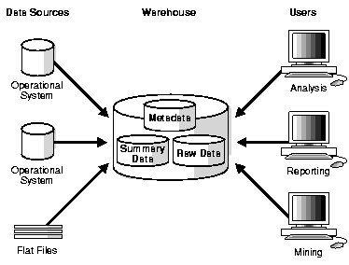
The Data Warehouse
Data Warehouse Architectures
The data warehouse contains summary data, metadata and raw data
Raw data: Data that has not been transformed, to the multi-dimensional format that is optimized for fast-response
Summary data: Data that has been transformed, to the multi-dimensional format that is optimized for fast-response queries
Metadata: Information about the data stored in the data warehouse e.g. who are the users who can access the data, where is the source of the data etc
Data warehouse data is typically historical and non-volatile

Slide 30
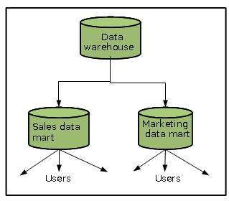
Data Mart
Data Warehouse Architectures
A data mart is a simple form of a data warehouse that is focused on a single subject
Data marts are often built and controlled by a single department within an organization
E.g. a Sales Data Mart, a Purchasing Data Mart
Data marts usually draw data from only a few sources, specific to the needs of the department who initiated it

Slide 31
ETL (Extract-Transform-Load)
Data Warehouse Architecture
ETL is an important component of the Data Warehousing Architecture
It is the process that enables data to be transferred from Operational Applications to the Staging Area, to the Data Warehouse and finally from the Data Warehouse into a set of Data Marts
It is also the process that transforms the data to the format that is eventually useful to the business user, e.g. correcting the values of inconsistent data, cleansing "bad" data, filtering the data and loading data into the target database

Slide 32
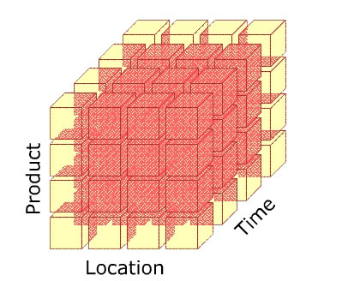
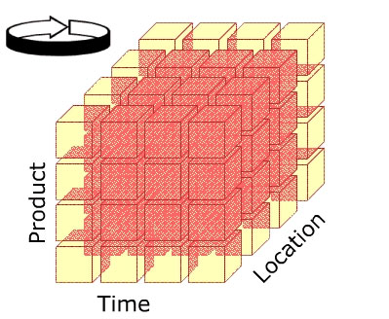
Data Warehouse stores data as Cubes
Data Warehouse Architectures
A major difference between a transactional database and data warehouse database is that the data warehouse uses the multidimensional data model instead of the Entity-Relation model to store its data
The Multidimensional data model views data in the form of a data cube
E.g. Sales data is stored in the data warehouse as a data cube, allowing it to be modeled and viewed in multiple dimensions
You will study more about the dimensional data model in Topic 3 of this module

Slide 33
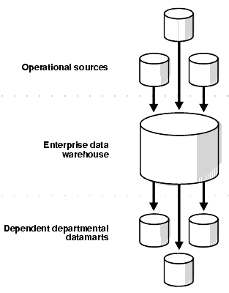
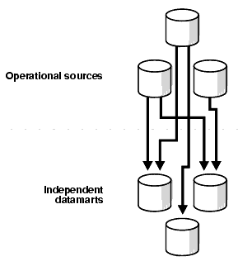
Data Marts Architecture
Data Marts
There are two basic types of data marts
Dependent data marts draw data from a central data warehouse that has already been created
Independent data marts, in contrast, are standalone systems built by drawing data directly from operational or external sources of data, or both.
Dependent Data Marts
Independent Data Marts

Slide 34
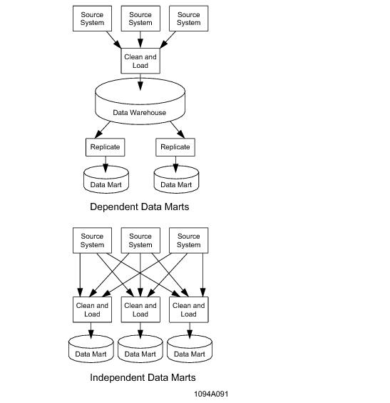
Independent Data Mart
Data Marts
Focuses on one subject area, not designed in an enterprise context
E.g. Manufacturing has their own Data Mart, HR has their own Data Mart etc
Gets data from multiple transaction systems in one subject area or department to support specific business needs
Analytic tools query data directly from data mart and present information to user

Slide 35
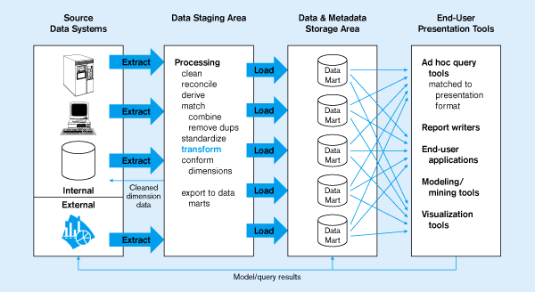
Independent Data Marts
Data Marts

Slide 36
Dependent Data Mart
Data Marts
Data is derived from the enterprise data warehouse
Data in the dependent data mart is reshaped and restructured into a form that very specifically meets the needs of the end user
The data marts are not separate databases but logical views of the data warehouse

Slide 37
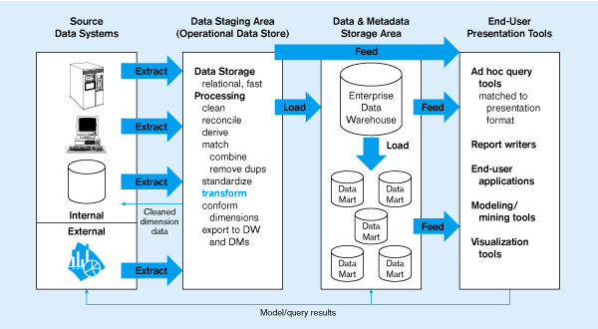
Dependent Data Marts
Data Warehouse Architectures

Slide 38
Data Marts vs Data Warehouses
Data Marts
A data warehouse deals with multiple subject areas and is typically implemented and controlled by corporate IT department
A data warehouse usually assembles data from multiple source systems
Data marts are typically smaller and less complex than data warehouses; hence, they are typically easier to build and maintain
Category | Data Warehouse | Data Mart
Scope | Corporate | Line of Business
Subject | Multiple | Single
Data Sources | Many | Few
Size (Typical) | 100 GB-TB+ | <100GB
Implementation Time | Months to years | Months

Slide 39

Why use Data Marts?
Data Marts
Data marts are optional. However, here are the reasons why companies may implement data marts:
Lower the risk for companies as it can be implemented in a much shorter time and with less financial resources
To give the right user the right access to the right data
To provide data in the desired form that matches the collective view of data by a group or users in a department or business function
To improve end-user response time

Slide 40
Other Data Warehouse Architectures
Data Warehouse Architectures
Besides the Centralized Data Warehouse Architecture and the Hub and Spoke Architecture, companies may also implement other architectures as shown on the right
Independent Data Marts
Data Mart Bus Architecture with Linked Dimensional Data Marts
@active Warehouse

Slide 41
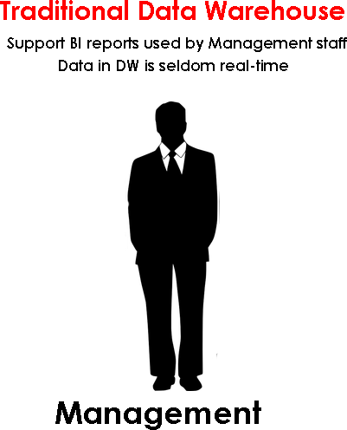
Active Data Warehouse (ADW)
@Active Data Warehouse
Traditional data warehouses are built to enable BI reporting for C-level executives and seldom require real-time information retrieval

Slide 42
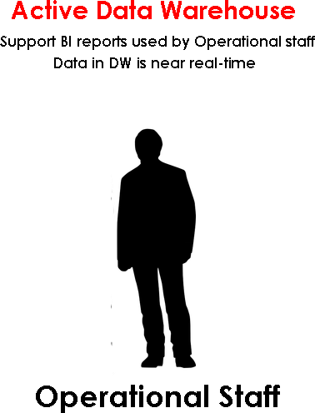
Active Data Warehouse (ADW)
@Active Data Warehouse
As usage of data warehouses matured, companies want to extend the data insights to their operational staff as well
However, unlike management staff who make long-term decisions, data insights are only useful to operational staff if it is near real-time as they make short-term decisions
Thus, in some companies, an active warehouse, which is a specialized form of data warehouse that can support near real-time data insights is used instead

Slide 43
Active Data Warehouse (ADW)
@Active Data Warehouse
Active data warehouses differ from traditional warehouses in that the lag time between the transfer between the operational data sources to the data warehouse is much shorter
In addition, the system is able to respond to real-time business events as they occur, completing complex analyses upon demand, and alerting people or systems to take action.
Closed loop system: Events are analysed as they occur, and intelligent decisions are promptly initiated.
Allows an organization to automatically respond to opportunities with agility, often without the need for human intervention

Slide 44
Active Data Warehouse (ADW)
@Active Data Warehouse
Used by operational staff to make real-time operational decisions such as:
Cross selling by Customer Service Representatives
Point-of-sale fraud detection
Personalized next best offer on web sites
Retail out-of-stock monitoring on promotional items
Labor and crew scheduling
Dynamic pricing and yield management
Real-time manufacturing line quality alerts

Slide 45
Data Warehouses store data differently
Data Warehouses vs Transactional Databases
Data in data warehouses stored differently from data in transactional databases
Transactional databases 3NF Entity-Relationship Model
Data Warehouse
Denormalized Dimensional Model

Slide 46
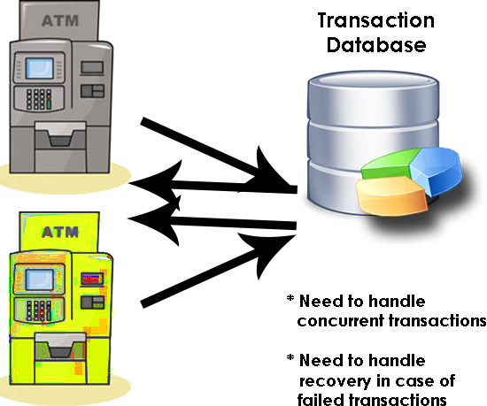
Data Warehouses store data differently
Data Warehouses vs Transactional Databases
Transactional databases are modelled to handle the requirements of Online Transactional processing (OLTP)
They must be able to efficiently retrieve or capture the relevant data when a transaction such as an ATM withdrawal occurs
They must also be able to handle concurrent updates and perform roll-back if a transaction fails

Slide 47
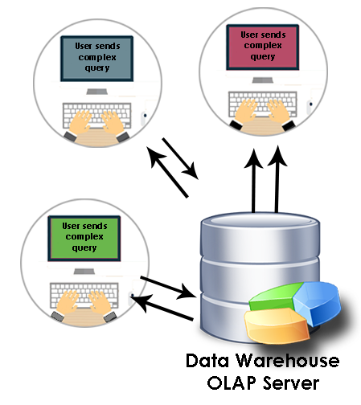
Data Warehouses store data differently
Data Warehouses vs Transactional Databases
On the other hand, data warehouse databases are modelled to handle the requirements of Online Analytical Processing (OLAP)
E.g. They must be able to effectively retrieve the data that matches a query submitted by the user

Slide 48
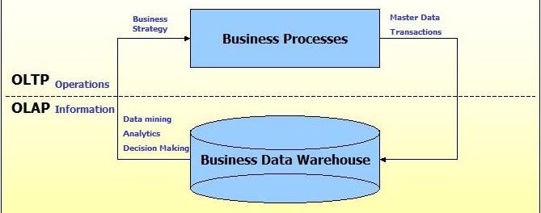
OLTP vs OLAP
Data Warehouse vs Transactional Database
Since the two types of databases are meant for different purposes, their characteristics are also different from each other

Slide 49
OLTP (On-line Transaction Processing)
Data Warehouse vs Transactional Database
OLTP (On-line Transaction Processing) systems are designed to:
capture and store data related to day-to-day business functions such as ERP, CRM, SCM, POS,
Increase the efficiency of an organization
Characteristics:
Involve a large number of short on-line transactions (INSERT, UPDATE, DELETE)
Requires data integrity in multi-access environments
Stores current data
Uses the 3NF (Third-Normal-Form) Schema

Slide 50
OLAP (On-line Analytical Processing)
Data Warehouse vs Transactional Database
OLAP (On-line Analytical Processing) systems are designed to:
facilitate analysis of business data
increase the effectiveness of organization
Characteristics:
Involve a relatively low volume of transactions
Requires ability to store large amounts of data and to handle complex queries
Contains aggregated, historical data
Uses multi-dimensional schemas such as Star Schema, Snowflake Schema
Notes:
OLAP tools increase the effectiveness of an organization because they allow the management of the company to gain a more complete picture of the organization’s progress in achieving its objectives
By knowing where the company stands in terms of achieving its KPIs, action can be taken at mid-way points to rectify and improve the company’s overall effectiveness in achieving those goals

Slide 51
Summary (1 of 2)
Data Warehouse vs Transactional Database
 | Transactional database | Data warehouse
Support what system? | Support OLTP systems | Support OLAP systems
How current is data? | Holds current data | Holds historic data
Granularity? | Stores detailed data | Stores summarized data
How often does data change? | Data is dynamic and real-time update | Data is largely static and periodic update
What is the data volume it stores? | In hundreds of gigabytes | In hundreds of terabytes or petabytes
What Data Model / Schema does it use? | Entity-Relation Model in 3NF | Dimensional model in denormalized format

Slide 52
Summary (2 of 2)
Data Warehouse vs Transactional Database
 | Transactional database | Data warehouse
What decisions does it support? | Supports day-to-day (short-term) decisions | Supports strategic (long-term) decisions
What is it optimized for? | Optimised for transactions | Optimised for query performance
What is it structured for? | Structured for data integrity | Structured for ease in querying
What is its pattern of usage | Predictable pattern of usage | Unpredicted pattern of usage

Slide 53
Requirements
Requirements of a Data Warehouse
Load Performance
Load Processing
Data Quality
Query Performance
Volume of Data
Multi-user Accessing
Networked Data Warehouse
Dimensional Support
Warehouse Administration
Notes:
In this section, we will talk about what you need to consider when deciding on a suitable RDBMS to implement the data warehouse.

Slide 54
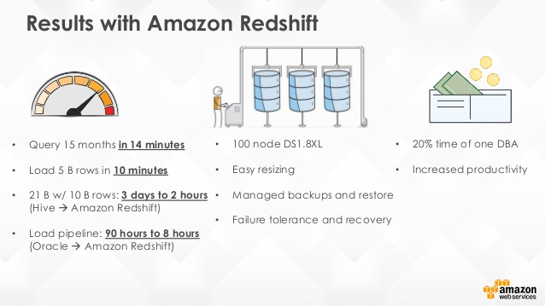
Requirements
Requirements for a Data Warehouse
Load Performance
A data warehouse requires incremental loading of new data on a periodic basis within narrow time windows.
Performance of the load process should be measured in hundreds or millions of rows per hour.

Slide 55
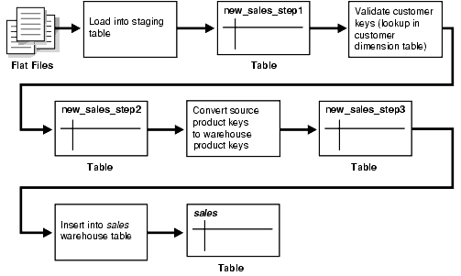
Requirements
Requirements for a Data Warehouse
Load Processing
Many steps must be taken to load new or updated data into the data warehouse, including data conversions, filtering, reformatting, indexing etc
These steps must be executed as a single seamless unit of work

Slide 56
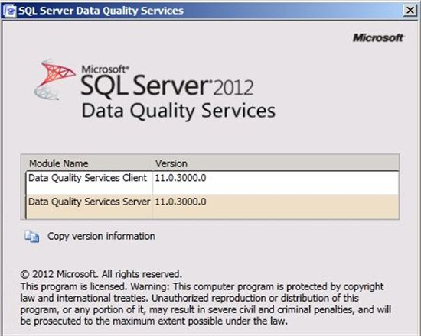
Requirements
Requirements for a Data Warehouse
Data Quality
Data quality determines the reliability of data for making decisions.
The data warehouse should be a source of complete and accurate data
Complete: Perform integrity checks, e.g. referential integrity
Accurate: Clean up common data problems like misspellings, typos, and random abbreviations

Slide 57
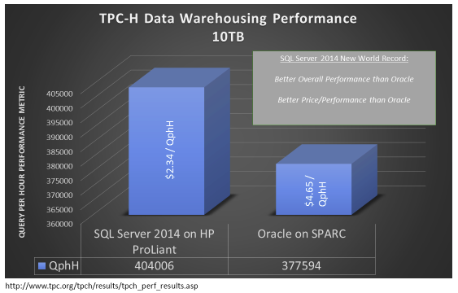
Requirements
Requirements for a Data Warehouse
Query performance
Complex queries must complete in reasonable time periods
E.g. in TPC-H benchmark test, SQL Server 2015 chalked up 404,005 query-per-hour (QphH)

Slide 58
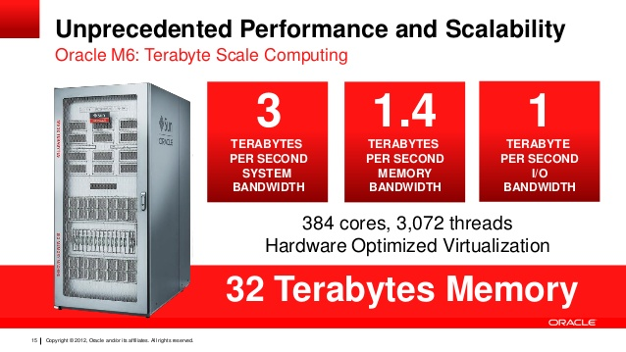
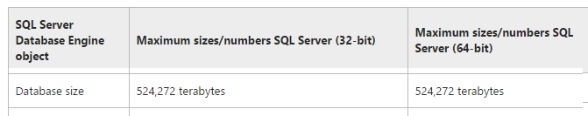
Requirements
Requirements for a Data Warehouse
Volume of data
Data warehouse sizes are growing at astonishing rates
RDBMS must be able to support these gigantic sizes

Slide 59
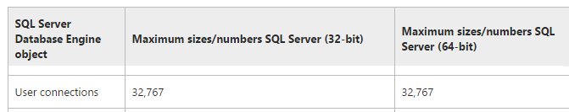
Requirements
Requirements for a Data Warehouse
Multi-user accessing
Data warehouse must be able to support thousands of concurrent users while maintaining acceptable query performance

Slide 60
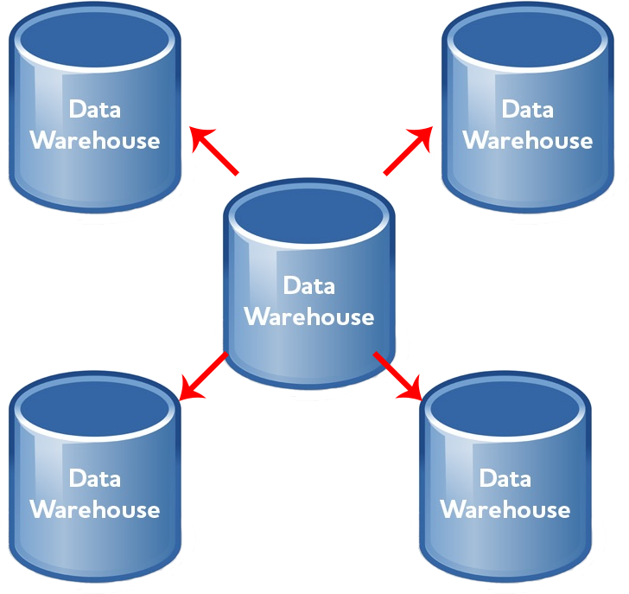
Requirements
Requirements for a Data Warehouse
Networked Data Warehouse
Data warehouses rarely exist in isolation
Multiple data warehouse systems co-operate in a larger network of data warehouses
The server must include tools that co-ordinate the movement of subsets of data between warehouses

Slide 61
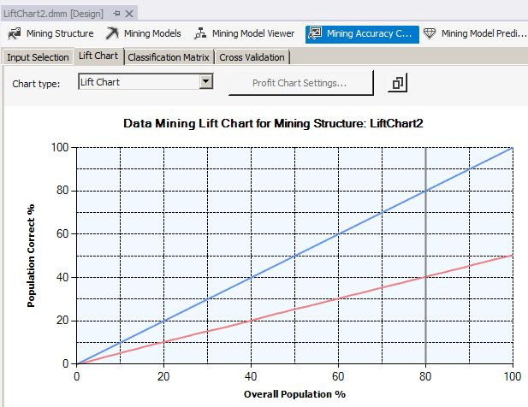
Requirements
Requirements for a Data Warehouse
Advanced Query Functionality
The RDBMS must provide a complete set of analytical operations to cater to the need of end users

Slide 62
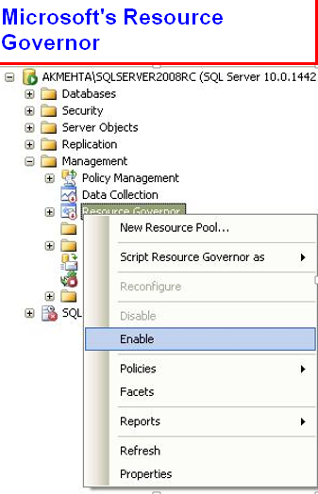
Requirements
Requirements for a Data Warehouse
Warehouse Administration
The very large scale and time-cyclic nature of the data warehouse demands administrative ease and flexibility
The RDBMS must provide controls such as implementing resource limits, charge back accounting, query prioritization, performance tuning

Slide 63
Reasons for a data warehouse
Reasons for a data warehouse
Reasons why a company should have a data warehouse
Reduce stress on production system
Faster return of query results
Integrate many sources of data
Provide historical intelligence
One version of the truth
Improve data quality
Easier to create reporting solutions on it
High ROI (Return on Investment)
Notes:
Reduce stress on production system
Without a data warehouse, if reports are needed, users will need to run reports directly against operational systems. This will cause performance issues to the production systems
Faster return of query results
The data warehouse is optimized for read access, resulting in faster report generation
Integrate many sources of data
Data warehouses can be built to integrate many different sources of data in near real-time. This will allow for better business decisions because users will have access to more data. Plus this will save users lots of time because they won’t waste precious time retrieving data from multiple sources
Provides historical intelligence
A data warehouse stores large amounts of historical data so you can analyze different time periods and trends in order to make future predictions. Such data typically cannot be stored in a transactional database or used to generate reports from a transactional system.
One version of the truth
Having one version of the truth, so each department will produce results that are in line with all the other departments, providing consistency
Improve data quality
A data warehouse implementation includes the conversion of data from numerous source systems into a common format. Since each data from the various departments is standardized, each department will produce results that are in line with all the other departments. So you can have more confidence in the accuracy of your data. And accurate data is the basis for strong business decisions.
Easier to create reporting solutions on it
Having a data warehouse makes it easy to create business intelligence solutions on top of it
High ROI
Companies that have implemented data warehouses and complementary BI systems have generated more revenue and saved more money than companies that haven’t invested in BI systems and data warehouses

Slide 64
Reasons for a data warehouse
Reasons for a data warehouse
Reduce stress on production system
Without a data warehouse, if reports are needed, users will need to run reports directly against operational systems.
This will cause performance issues to the production systems
Faster return of query results
The data warehouse is optimized for read access, resulting in faster report generation
.
Notes:
Reduce stress on production system
Without a data warehouse, if reports are needed, users will need to run reports directly against operational systems. This will cause performance issues to the production systems
Faster return of query results
The data warehouse is optimized for read access, resulting in faster report generation
Integrate many sources of data
Data warehouses can be built to integrate many different sources of data in near real-time. This will allow for better business decisions because users will have access to more data. Plus this will save users lots of time because they won’t waste precious time retrieving data from multiple sources
Provides historical intelligence
A data warehouse stores large amounts of historical data so you can analyze different time periods and trends in order to make future predictions. Such data typically cannot be stored in a transactional database or used to generate reports from a transactional system.
One version of the truth
Having one version of the truth, so each department will produce results that are in line with all the other departments, providing consistency
Improve data quality
A data warehouse implementation includes the conversion of data from numerous source systems into a common format. Since each data from the various departments is standardized, each department will produce results that are in line with all the other departments. So you can have more confidence in the accuracy of your data. And accurate data is the basis for strong business decisions.
Easier to create reporting solutions on it
Having a data warehouse makes it easy to create business intelligence solutions on top of it
High ROI
Companies that have implemented data warehouses and complementary BI systems have generated more revenue and saved more money than companies that haven’t invested in BI systems and data warehouses

Slide 65
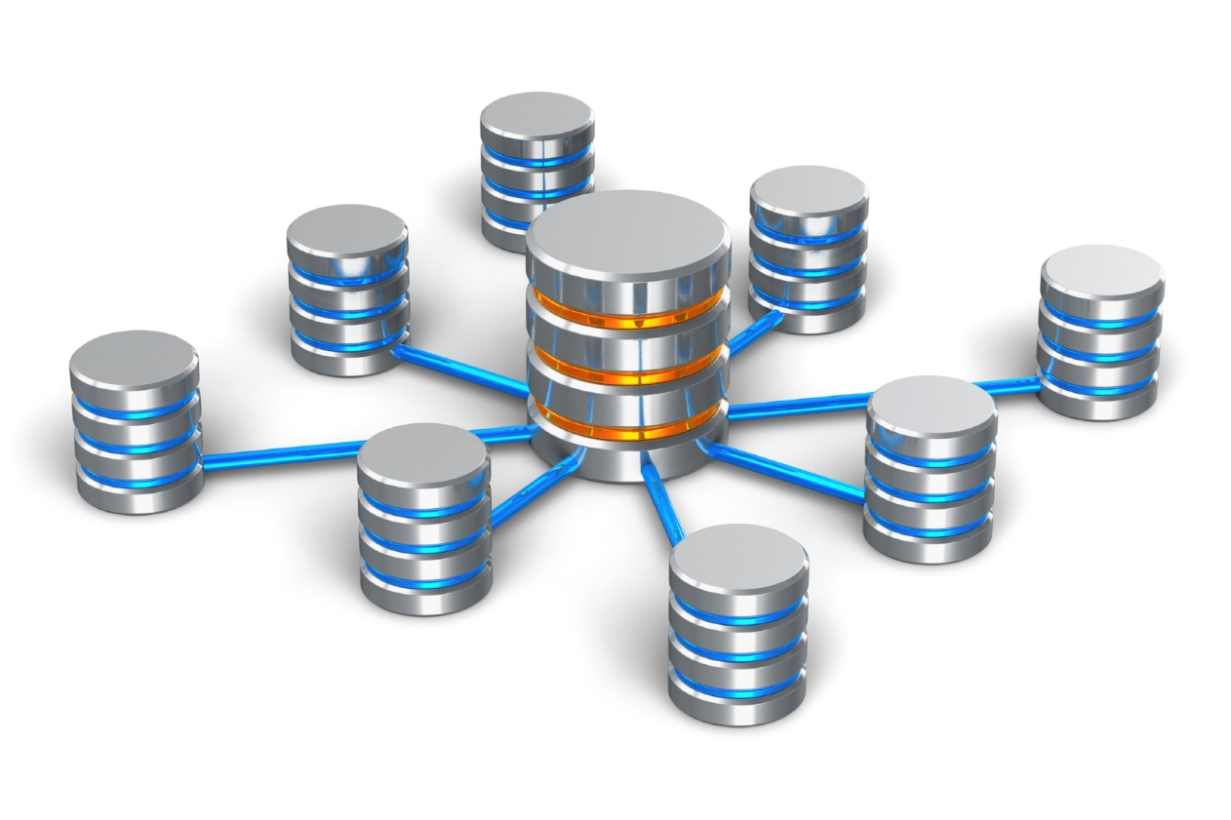
Reasons for a data warehouse
Reasons for a data warehouse
Integrate many sources of data
Data warehouses can be built to integrate many different sources of data in near real-time.
This will allow for better business decisions because users will have access to more data.
Plus this will save users lots of time because they won’t waste precious time retrieving data from multiple sources
Notes:
Reduce stress on production system
Without a data warehouse, if reports are needed, users will need to run reports directly against operational systems. This will cause performance issues to the production systems
Faster return of query results
The data warehouse is optimized for read access, resulting in faster report generation
Integrate many sources of data
Data warehouses can be built to integrate many different sources of data in near real-time. This will allow for better business decisions because users will have access to more data. Plus this will save users lots of time because they won’t waste precious time retrieving data from multiple sources
Provides historical intelligence
A data warehouse stores large amounts of historical data so you can analyze different time periods and trends in order to make future predictions. Such data typically cannot be stored in a transactional database or used to generate reports from a transactional system.
One version of the truth
Having one version of the truth, so each department will produce results that are in line with all the other departments, providing consistency
Improve data quality
A data warehouse implementation includes the conversion of data from numerous source systems into a common format. Since each data from the various departments is standardized, each department will produce results that are in line with all the other departments. So you can have more confidence in the accuracy of your data. And accurate data is the basis for strong business decisions.
Easier to create reporting solutions on it
Having a data warehouse makes it easy to create business intelligence solutions on top of it
High ROI
Companies that have implemented data warehouses and complementary BI systems have generated more revenue and saved more money than companies that haven’t invested in BI systems and data warehouses

Slide 66

Reasons for a data warehouse
Reasons for a data warehouse
Provides historical intelligence
A data warehouse stores large amounts of historical data
So you can analyze different time periods and trends in order to make future predictions
Such data typically cannot be stored in a transactional database or used to generate reports from a transactional system.
Notes:
Reduce stress on production system
Without a data warehouse, if reports are needed, users will need to run reports directly against operational systems. This will cause performance issues to the production systems
Faster return of query results
The data warehouse is optimized for read access, resulting in faster report generation
Integrate many sources of data
Data warehouses can be built to integrate many different sources of data in near real-time. This will allow for better business decisions because users will have access to more data. Plus this will save users lots of time because they won’t waste precious time retrieving data from multiple sources
Provides historical intelligence
A data warehouse stores large amounts of historical data so you can analyze different time periods and trends in order to make future predictions. Such data typically cannot be stored in a transactional database or used to generate reports from a transactional system.
One version of the truth
Having one version of the truth, so each department will produce results that are in line with all the other departments, providing consistency
Improve data quality
A data warehouse implementation includes the conversion of data from numerous source systems into a common format. Since each data from the various departments is standardized, each department will produce results that are in line with all the other departments. So you can have more confidence in the accuracy of your data. And accurate data is the basis for strong business decisions.
Easier to create reporting solutions on it
Having a data warehouse makes it easy to create business intelligence solutions on top of it
High ROI
Companies that have implemented data warehouses and complementary BI systems have generated more revenue and saved more money than companies that haven’t invested in BI systems and data warehouses

Slide 67

Reasons for a data warehouse
Reasons for a data warehouse
One version of the truth
Having one version of the truth, so each department will produce results that are in line with all the other departments, providing consistency
Improve data quality
A data warehouse implementation includes the conversion of data from numerous source systems into a common format.
Since each data from the various departments is standardized, each department will produce results that are in line with all the other departments. So you can have more confidence in the accuracy of your data. And accurate data is the basis for strong business decisions.
Notes:
Reduce stress on production system
Without a data warehouse, if reports are needed, users will need to run reports directly against operational systems. This will cause performance issues to the production systems
Faster return of query results
The data warehouse is optimized for read access, resulting in faster report generation
Integrate many sources of data
Data warehouses can be built to integrate many different sources of data in near real-time. This will allow for better business decisions because users will have access to more data. Plus this will save users lots of time because they won’t waste precious time retrieving data from multiple sources
Provides historical intelligence
A data warehouse stores large amounts of historical data so you can analyze different time periods and trends in order to make future predictions. Such data typically cannot be stored in a transactional database or used to generate reports from a transactional system.
One version of the truth
Having one version of the truth, so each department will produce results that are in line with all the other departments, providing consistency
Improve data quality
A data warehouse implementation includes the conversion of data from numerous source systems into a common format. Since each data from the various departments is standardized, each department will produce results that are in line with all the other departments. So you can have more confidence in the accuracy of your data. And accurate data is the basis for strong business decisions.
Easier to create reporting solutions on it
Having a data warehouse makes it easy to create business intelligence solutions on top of it
High ROI
Companies that have implemented data warehouses and complementary BI systems have generated more revenue and saved more money than companies that haven’t invested in BI systems and data warehouses

Slide 68
Reasons for a data warehouse
Reasons for a data warehouse
Improve data quality
A data warehouse implementation includes the conversion of data from numerous source systems into a common format.
Since each data from the various departments is standardized, each department will produce results that are in line with all the other departments.
So you can have more confidence in the accuracy of your data. And accurate data is the basis for strong business decisions.
Notes:
Reduce stress on production system
Without a data warehouse, if reports are needed, users will need to run reports directly against operational systems. This will cause performance issues to the production systems
Faster return of query results
The data warehouse is optimized for read access, resulting in faster report generation
Integrate many sources of data
Data warehouses can be built to integrate many different sources of data in near real-time. This will allow for better business decisions because users will have access to more data. Plus this will save users lots of time because they won’t waste precious time retrieving data from multiple sources
Provides historical intelligence
A data warehouse stores large amounts of historical data so you can analyze different time periods and trends in order to make future predictions. Such data typically cannot be stored in a transactional database or used to generate reports from a transactional system.
One version of the truth
Having one version of the truth, so each department will produce results that are in line with all the other departments, providing consistency
Improve data quality
A data warehouse implementation includes the conversion of data from numerous source systems into a common format. Since each data from the various departments is standardized, each department will produce results that are in line with all the other departments. So you can have more confidence in the accuracy of your data. And accurate data is the basis for strong business decisions.
Easier to create reporting solutions on it
Having a data warehouse makes it easy to create business intelligence solutions on top of it
High ROI
Companies that have implemented data warehouses and complementary BI systems have generated more revenue and saved more money than companies that haven’t invested in BI systems and data warehouses

Slide 69

Reasons for a data warehouse
Reasons for a data warehouse
Easier to create reporting solutions on it
Having a data warehouse makes it easy to create business intelligence solutions on top of it
High ROI
Companies that have implemented data warehouses and complementary BI systems have generated more revenue and saved more money than companies that haven’t invested in BI systems and data warehouses
Notes:
Reduce stress on production system
Without a data warehouse, if reports are needed, users will need to run reports directly against operational systems. This will cause performance issues to the production systems
Faster return of query results
The data warehouse is optimized for read access, resulting in faster report generation
Integrate many sources of data
Data warehouses can be built to integrate many different sources of data in near real-time. This will allow for better business decisions because users will have access to more data. Plus this will save users lots of time because they won’t waste precious time retrieving data from multiple sources
Provides historical intelligence
A data warehouse stores large amounts of historical data so you can analyze different time periods and trends in order to make future predictions. Such data typically cannot be stored in a transactional database or used to generate reports from a transactional system.
One version of the truth
Having one version of the truth, so each department will produce results that are in line with all the other departments, providing consistency
Improve data quality
A data warehouse implementation includes the conversion of data from numerous source systems into a common format. Since each data from the various departments is standardized, each department will produce results that are in line with all the other departments. So you can have more confidence in the accuracy of your data. And accurate data is the basis for strong business decisions.
Easier to create reporting solutions on it
Having a data warehouse makes it easy to create business intelligence solutions on top of it
High ROI
Companies that have implemented data warehouses and complementary BI systems have generated more revenue and saved more money than companies that haven’t invested in BI systems and data warehouses

Slide 70


